Slide 1
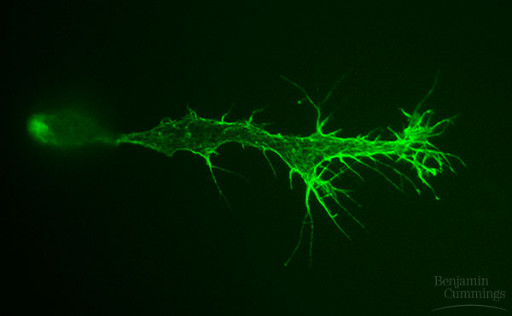
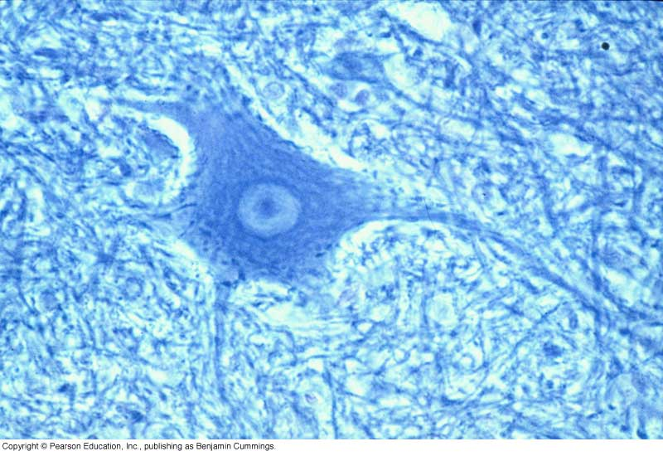
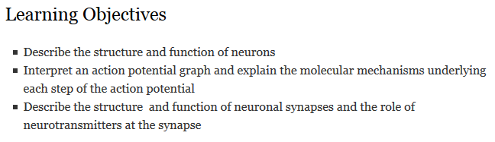
Neurons & Electrical Messages
Notes:
The human brain Contains an estimated 100 billion nerve cells, or neurons
magnetic resonance imaging Is a technology that can reconstruct a three-dimensional map of brain activity

Slide 2
Key Concepts: Neurons
Neurons are cells that transmit electrical signals
They do this through
Action potentials (electrical signals) – within one neuron
Neurotransmitters (chemical signals) – to the next neuron
Action potential
Rapid, temporary change in membrane potential
Sodium rushes in
Potassium rushes out
Neurotransmitters
Rapidly, temporarily change membrane potential of receiving cell
Notes:
Neurons are cells that transmit electrical signals.
During an action potential, an inflow of sodium ions is followed by an outflow of potassium ions.
At synapses, the neurotransmitter causes a change in the receiving cell’s membrane potential.
Vertebrates have a central nervous system (CNS) and a peripheral nervous system (PNS).
They have a membrane potential, which is an electric potential, or voltage, due to differences in the concentrations of ions on the two sides of the plasma membrane.
Changes in membrane voltage are called action potentials.
An electrical signal from one neuron is converted to a chemical signal in the form of a neurotransmitter.
PNS neurons receive sensory information and transmit it to the CNS for processing. The CNS then sends signals to muscles, glands, or other target tissues via other PNS neurons.

Slide 3
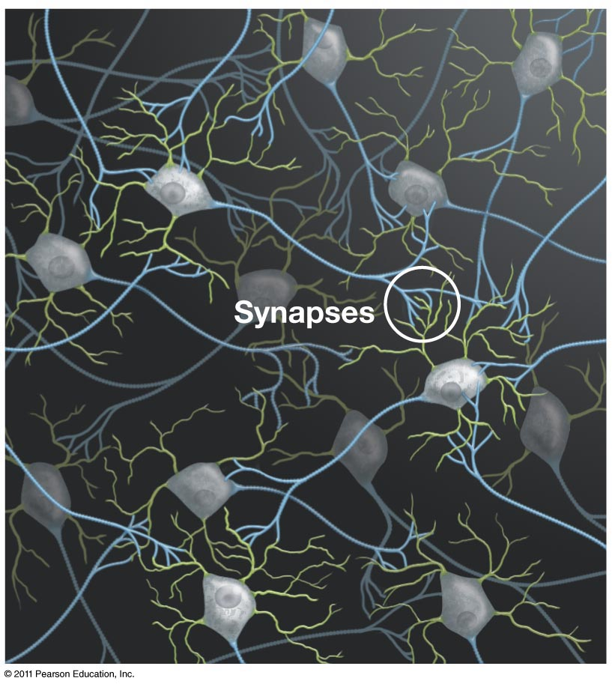
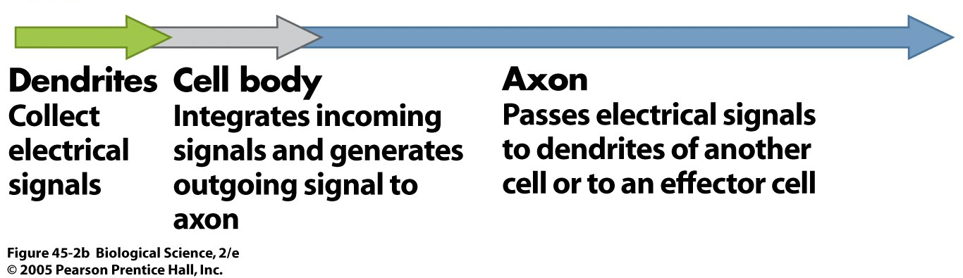
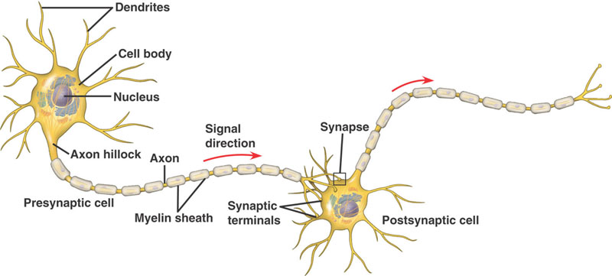
Neuron Structure
Figure 48.4, Campbell & Reece
Notes:
Most of a neuron’s organelles Are located in the cell body
Dendrites Highly branched extensions that receive signals from other neurons
The axon is typically a much longer extension That transmits signals to other cells at synapses; That may be covered with a myelin sheath
A dendrite receives electrical signals from the axons of adjacent cells. The axon then sends the signal to the dendrites of other neurons. The cell body, or soma, which includes the nucleus, integrates the incoming signals and generates an outgoing signal in the axon.

Slide 4
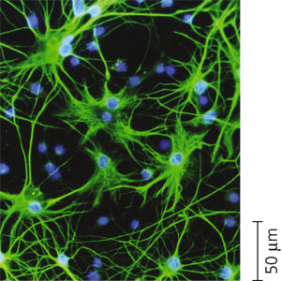
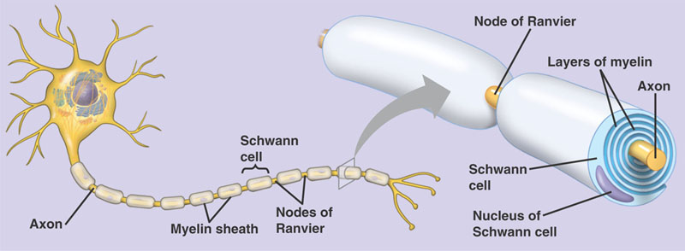
Supporting cells
Glia provide structural and functional support for neurons
Maintain interstitial fluid, increase blood flow to active neurons
Astrocytes: structural support, regulate extracellular ions & nts
Oligodendrites (CNS) & Schwann cells (PNS): form myelin sheaths around axons
Figure 48.3, Campbell & Reece
Notes:
Glia are supporting cells That are essential for the structural integrity of the nervous system and for the normal functioning of neurons
Astrocytes Provide structural support for neurons and regulate the extracellular concentrations of ions and neurotransmitters
Oligodendrocytes (in the CNS) and Schwann cells (in the PNS) Are glia that form the myelin sheaths around the axons of many vertebrate neurons

Slide 5
Neuron communication
Resting potential
Action potential
Neurotransmitters

Slide 6
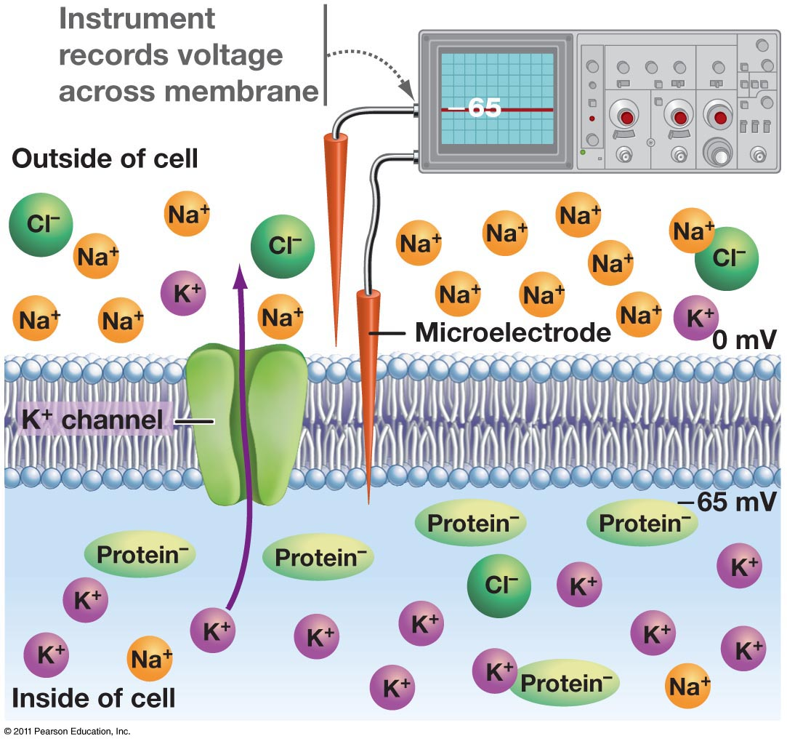
“resting” neuron’s membrane potential is –65 mV
Resting potential: membrane potential of a neuron that is not transmitting signals
The concentration of Na⁺ is higher outside the cell
The concentration of K⁺ is higher inside the cell
The sodium-potassium pump maintains the resting potential
Where should K, Na, Cl, and proteins diffuse, if given opportunity?
Notes:
Across its plasma membrane, every cell has a voltage Called a membrane potential
A difference of electrical charge between any two points creates a difference in electrical potential, or a voltage.
The inside of a cell is negative Relative to the outside
A microelectrode is made from a glass capillary tube filled with an electrically conductive salt solution. One end of the tube tapers to an extremely fine tip (diameter < 1 µm). While looking through a microscope, the experimenter uses a micropositioner to insert the tip of the microelectrode into a cell. A voltage recorder (usually an oscilloscope or a computer-based system) measures the voltage between the microelectrode tip inside the cell and a reference electrode placed in the solution outside the cell.
A neuron that is not transmitting signals Contains many open K⁺ channels and fewer open Na⁺ channels in its plasma membrane
The diffusion of K⁺ and Na⁺ through these channels Leads to a separation of charges across the membrane, producing the resting potential

Slide 7
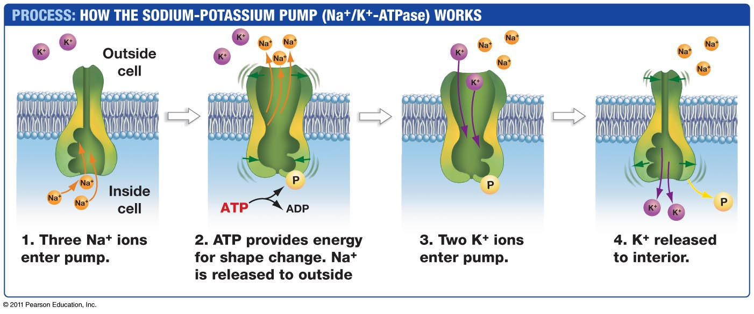
Resting potential relies on ionic gradients established by the sodium-potassium pump

Slide 8
Resting potential relies on ionic gradients
In resting neurons, only K⁺ can cross the membrane easily, via K⁺ “leak” channels
Though it can move freely across the membrane though potassium leak channels, potassium does NOT keep moving out of the cell until it is evenly distributed across the membrane. How can this be explained via the electrochemical gradient?
Notes:
Ion channels are pores in the membrane that allow only specific ions to pass through.
As K⁺ moves from the interior of the cell to the exterior via K⁺ channels, the inside of the cell becomes more negatively charged relative to the outside. Eventually, the membrane reaches a voltage at which there is equilibrium between the concentration gradient that moves K⁺ out and the electrical gradient that moves K⁺ in. This is called the equilibrium potential.
Na⁺/K⁺-ATPase pumps Na⁺ out

Slide 9
Depolarization of the membrane
The membrane potential changes in response to stimuli that open or close the gated ion channels
Hyperpolarization increases the magnitude of the membrane potential (becomes more negative)
Depolarization reduces the magnitude of the membrane potential (becomes more positive)
Not all depolarizations result in an action potential. When the stimulus is strong enough/frequent enough to depolarize the membrane potential beyond a specific threshold, it triggers an action potential
Notes:
Hyperpolarization increase the magnitude of the membrane potential
Depolarization is a reduction of the magnitude of the membrane potential
*magnitude of the change in membrane potential varies with the strength of the stimulus
In most neurons, depolarizations Are graded only up to a certain membrane voltage, called the threshold
A stimulus strong enough to produce a depolarization that reaches the threshold Triggers a different type of response, called an action potential
An action potential Is a brief all-or-none depolarization of a neuron’s plasma membrane; Is the type of signal that carries information along axons

Slide 10
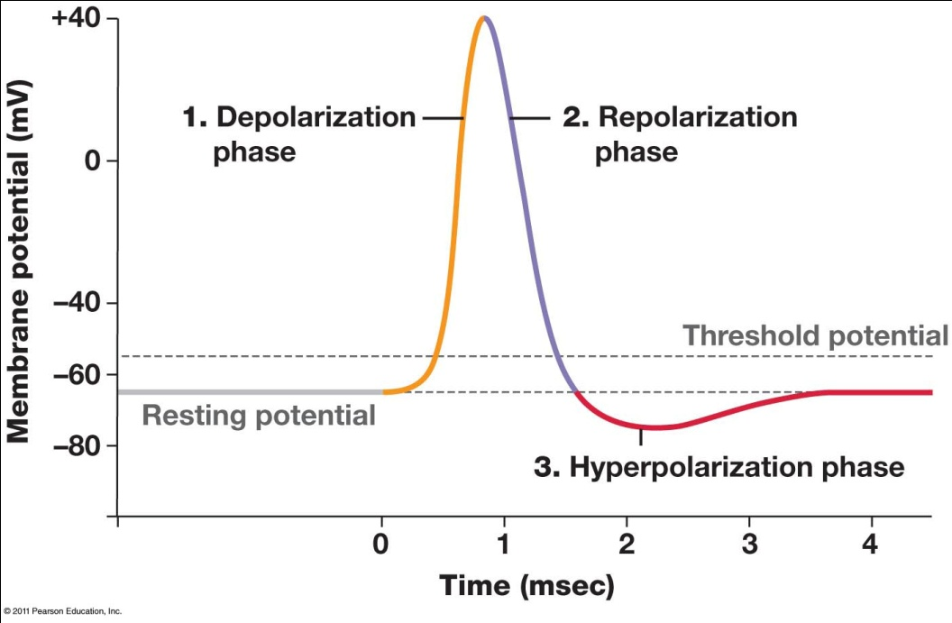
What is the action potential?
3 steps:
Depolarization
Repolarization
Hyperpolarization
“All-or-nothing” (strength/speed down the axon are always the same for a given axon)
Mediated by voltage-gated ion channels
Notes:
An action potential is a rapid, temporary change in a membrane potential and has three phases: depolarization, repolarization, and the undershoot.

Slide 11
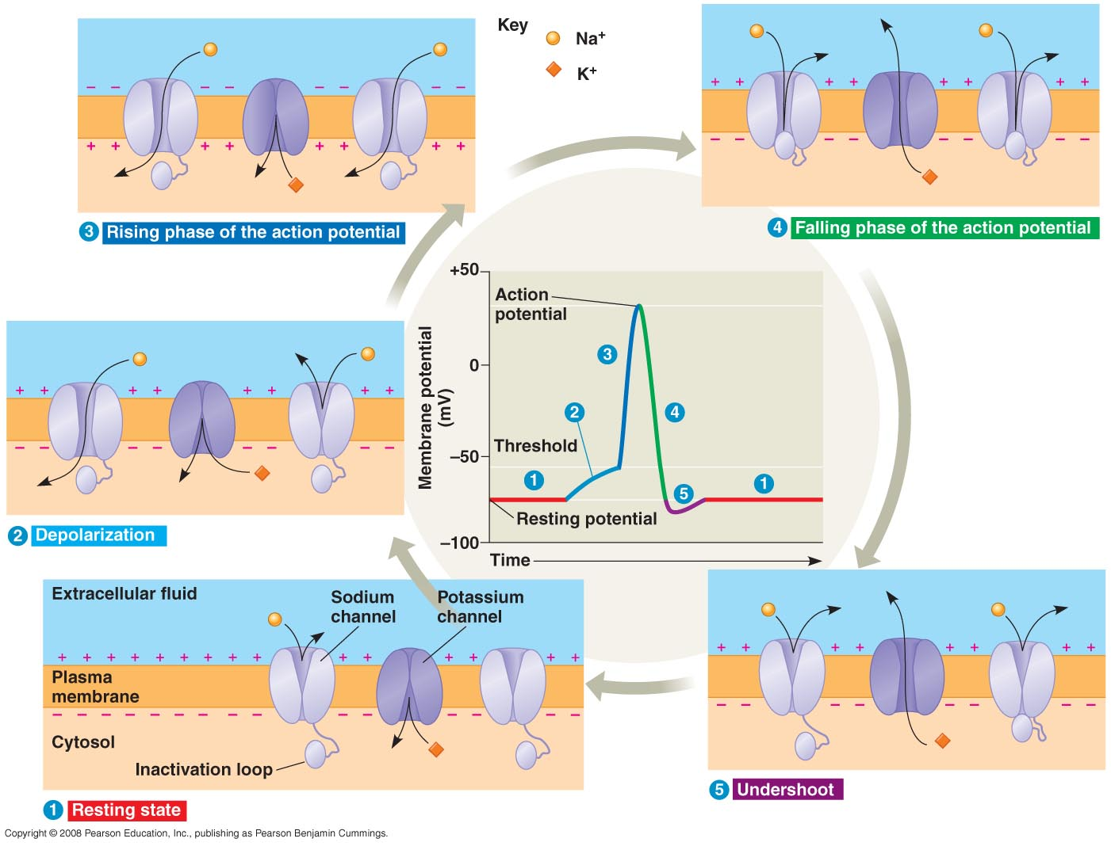
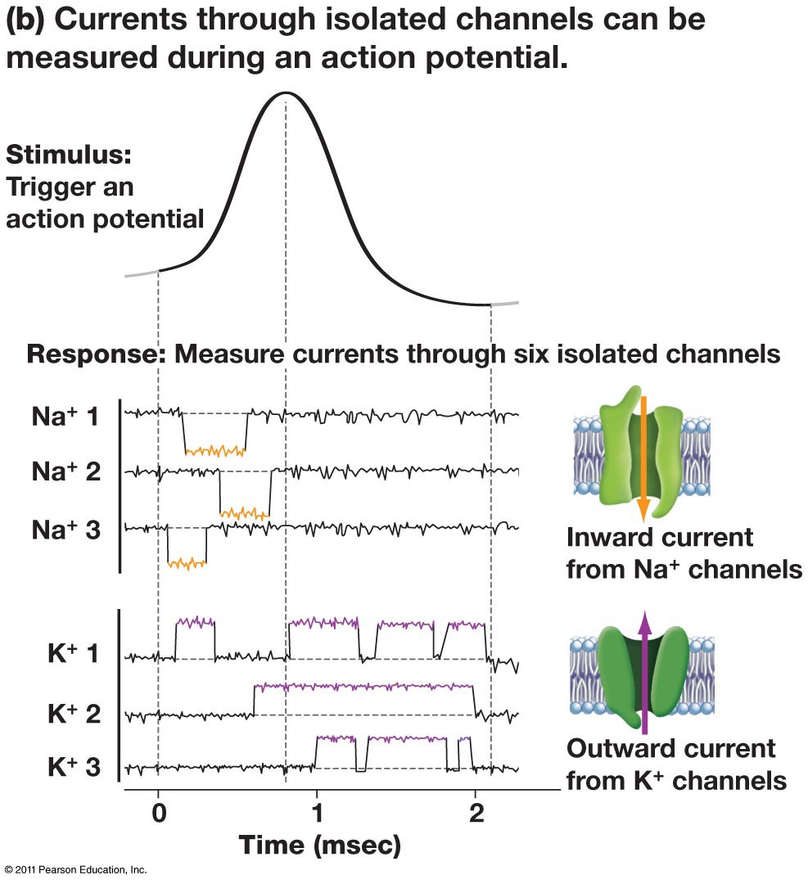
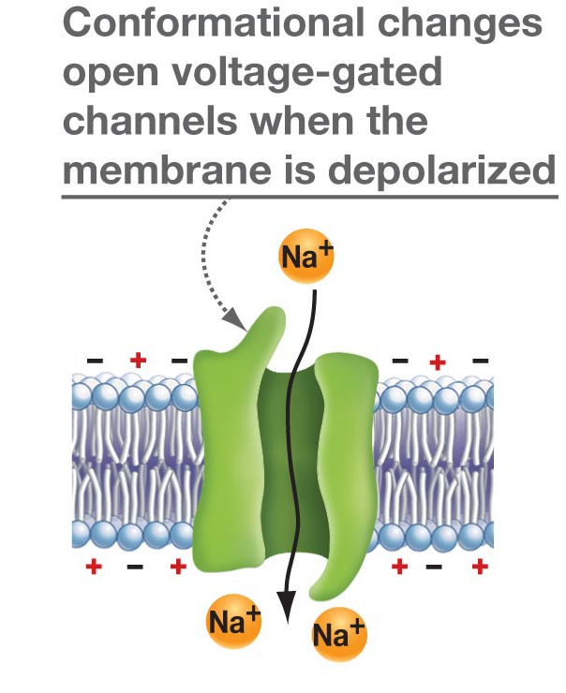
Notes:
1 Neuron at rest, gated channels are closed
2 stimulus opens channels, influx of Na
3 continued influx of Na
4. Gated K channels open, rapid outflow
5. Some gated K channels remain open

Slide 12
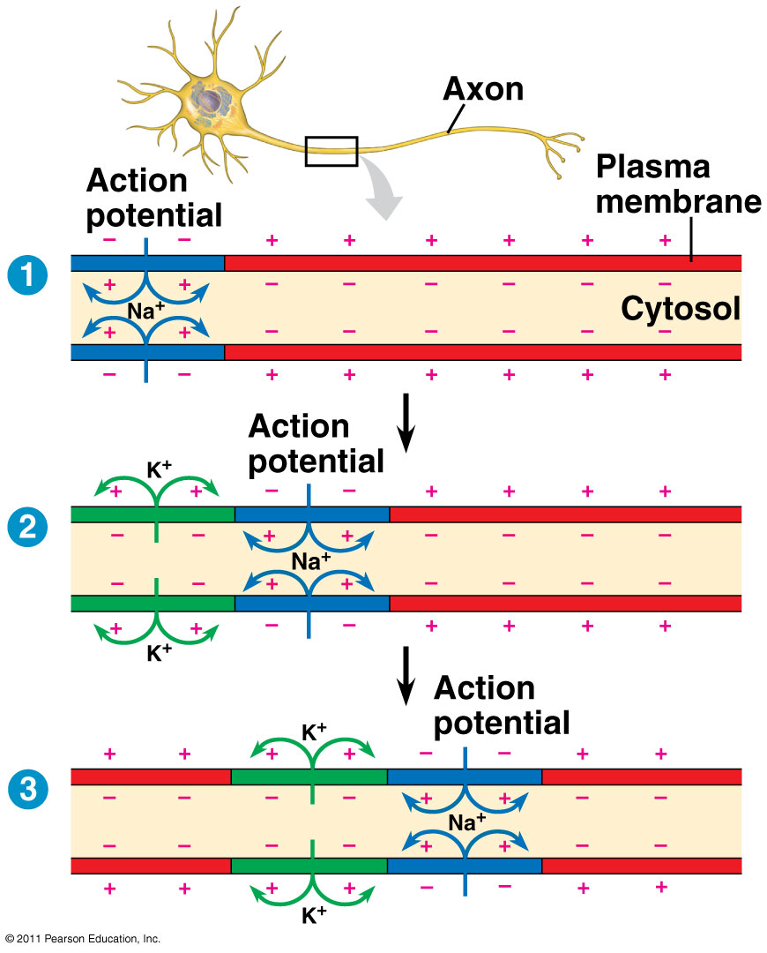
Repolarization and hyperpolarization occur after depolarization
Sodium channels open quickly after depolarization.
As Na⁺ rushes into the axon, the inside becomes electrically positive.
Shortly after the initial depolarization, the sodium channels close and remain inactive for 1 to 2 milliseconds.
Potassium channels open with a delay after depolarization and allow efflux of potassium, causing the membrane to hyperpolarize.
Notes:
Sodium channels open quickly after depolarization, stay open for about a millisecond, and then close. As Na⁺ rushes into the axon, the inside becomes electrically positive. Shortly after the initial depolarization, the sodium channels close and remain inactive for 1 to 2 milliseconds. Once the sodium channels close, they have a lag before they can open again.
Potassium channels open with a delay after depolarization. They continue to flip open and closed until the membrane repolarizes. Once the membrane returns to the resting potential, these channels remain closed.
Hyperpolarization increase the magnitude of the membrane potential
Depolarization is a reduction of the magnitude of the membrane potential
*magnitude of the change in membrane potential varies with the strength of the stimulus
In most neurons, depolarizations Are graded only up to a certain membrane voltage, called the threshold
A stimulus strong enough to produce a depolarization that reaches the threshold Triggers a different type of response, called an action potential
An action potential Is a brief all-or-none depolarization of a neuron’s plasma membrane; Is the type of signal that carries information along axons

Slide 13
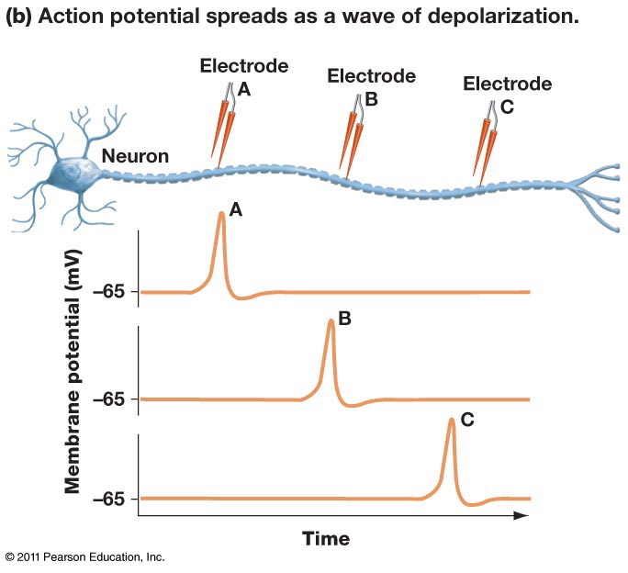
The action potential proceeds down the length of the axon

Slide 14
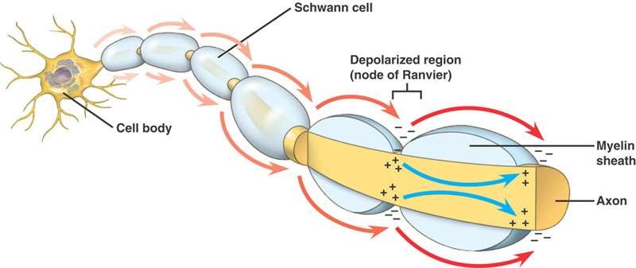
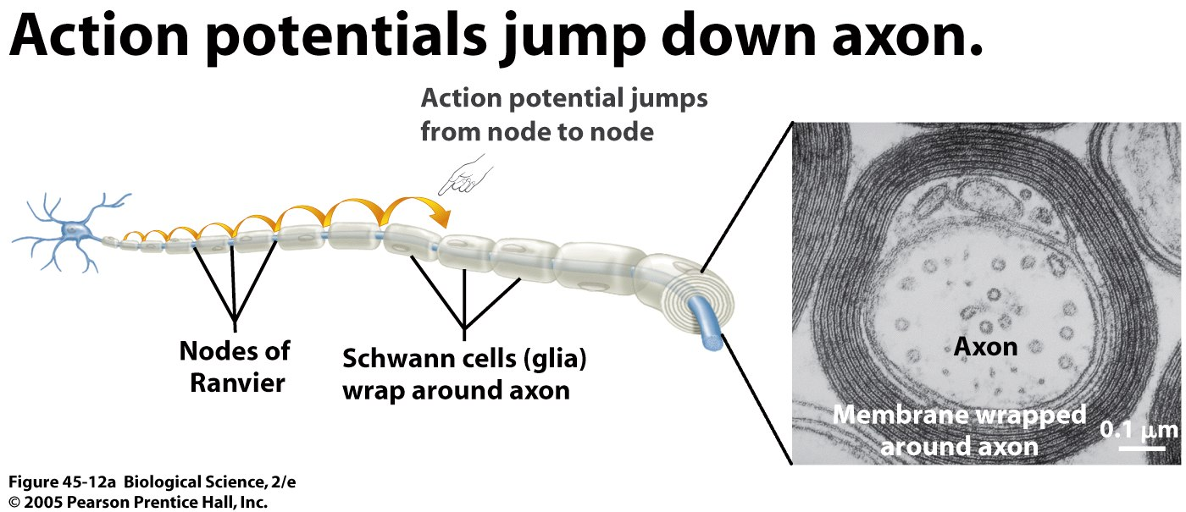
Rapid conduction of action potentials
The speed of action potential for a given neuron (relative to another neuron) is increased by either:
Greater axon diameter
Myelination
Saltatory conduction refers to the movement of an action potential in a myelinated axon
Figure 48.12,13, Campbell & Reece
Notes:
The speed of an action potential Increases with the diameter of an axon
In vertebrates, axons are myelinated Also causing the speed of an action potential to increase
Action potentials in myelinated axons Jump between the nodes of Ranvier in a process called saltatory conduction
Myelination insulates the axon and prevents charge from leaking out as it spreads down an axon. Thus, the influx of charge that results from an action potential spreads unimpeded until it hits an unmyelinated section of the axon, called a node of Ranvier. Electrical signals jump from node to node much faster than if the entire neuron were unmyelinated.
If myelin degenerates, the transmission of electrical signals slows considerably. The disease multiple sclerosis (MS) develops as damage to myelin increases and electrical signaling is impaired, causing the muscles to weaken and coordination to lessen.

Slide 15
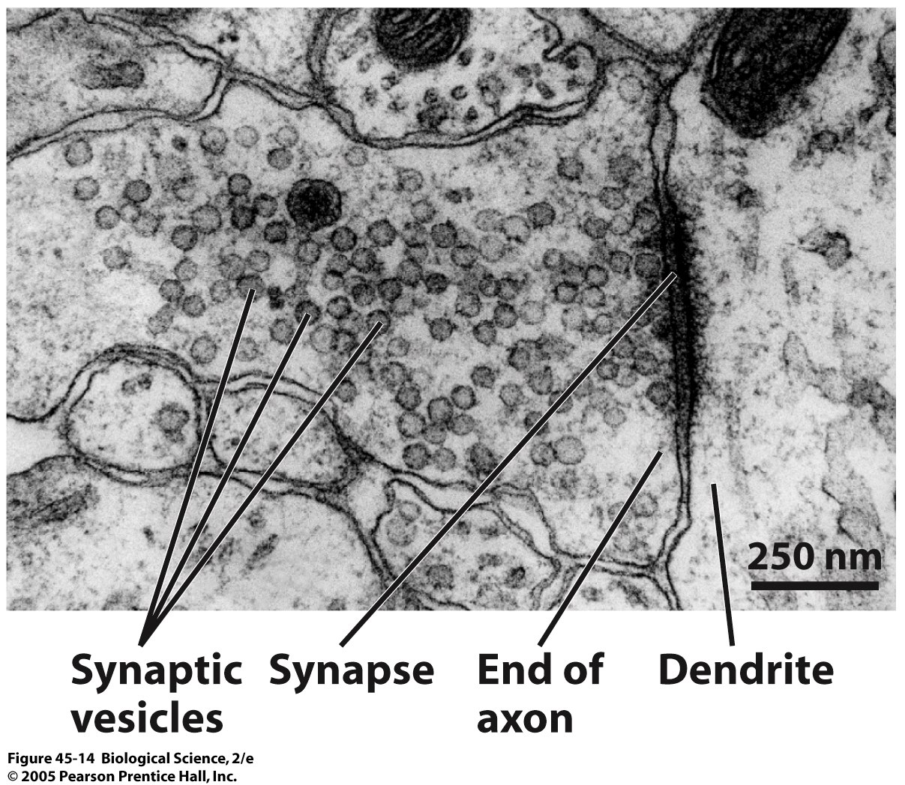
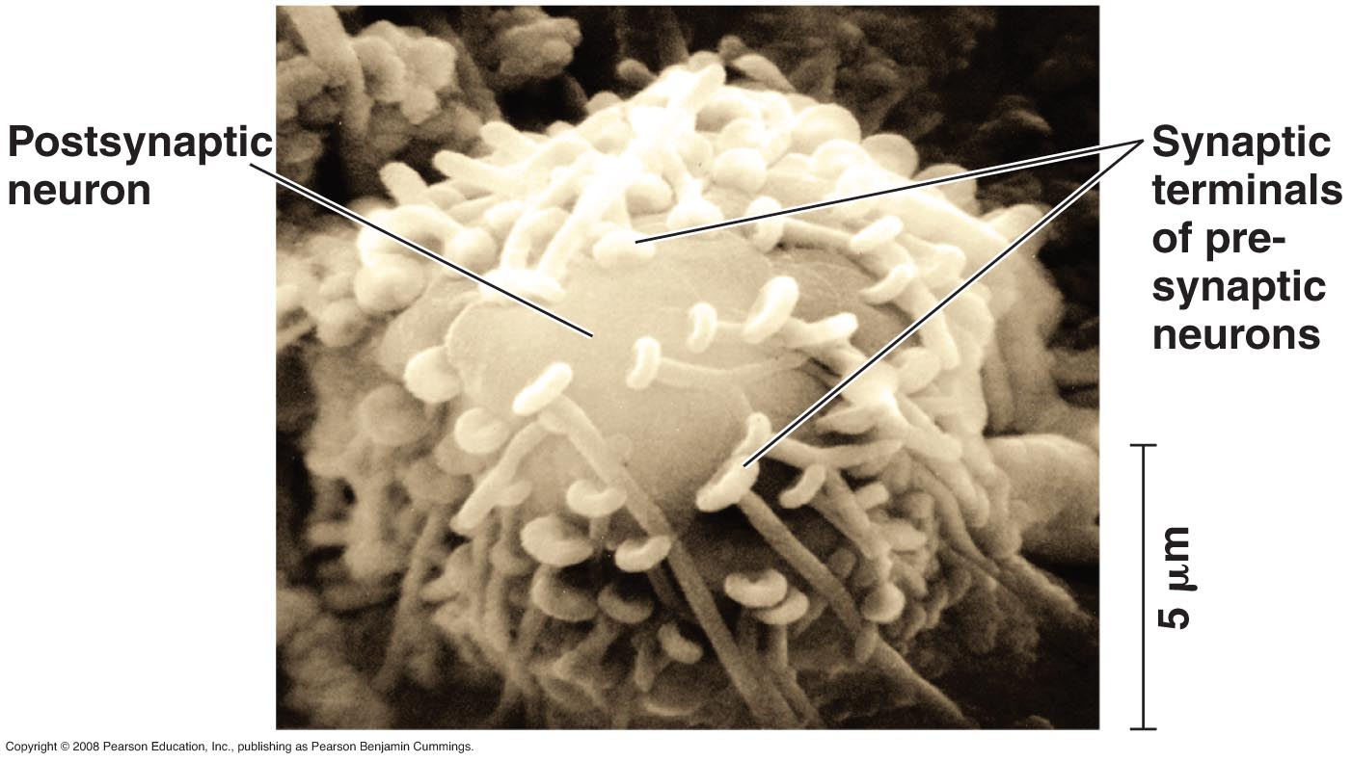
Passing the action potential between neurons
Neurotransmitters convey electrical signals from neuron to neuron or from neuron to target cell.
Stored in synaptic vesicles within the axon
The interface between two neurons is called a synapse.
There is a physical gap between synapsed neurons which is crossed by neurotransmitters
Notes:
Neurons communicate with other cells at synapses
In an electrical synapse Electrical current flows directly from one cell to another via a gap junction
The vast majority of synapses Are chemical synapses
In a chemical synapse, a presynaptic neuron Releases chemical neurotransmitters, which are stored in the synaptic terminal
The process of direct synaptic transmission Involves the binding of neurotransmitters to ligand-gated ion channels
In indirect synaptic transmission A neurotransmitter binds to a receptor that is not part of an ion channel
This binding activates a signal transduction pathway Involving a second messenger in the postsynaptic cell, producing a slowly developing but long-lasting effect

Slide 16
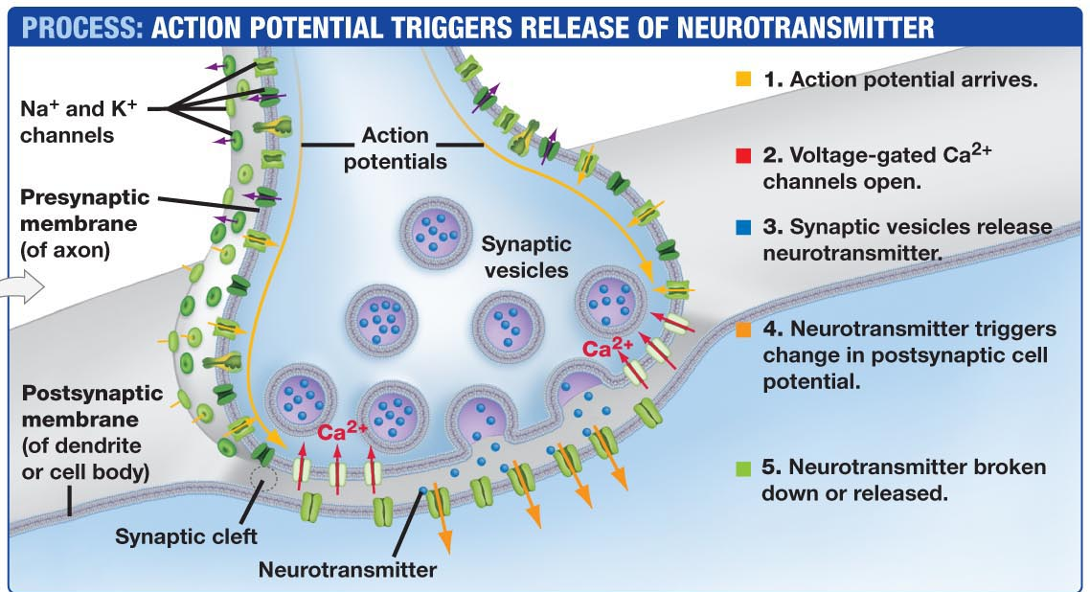
Notes:
There are several categories of neurotransmitters (Table 45.2). Many neurotransmitters function as ligands—molecules that bind to a specific site on a receptor molecule—that bind to ligand-gated ion channels.
Some other neurotransmitters bind to receptors that activate enzymes for production of a second messenger that may trigger changes in gene expression, enzyme activity, or membrane potential.

Slide 17
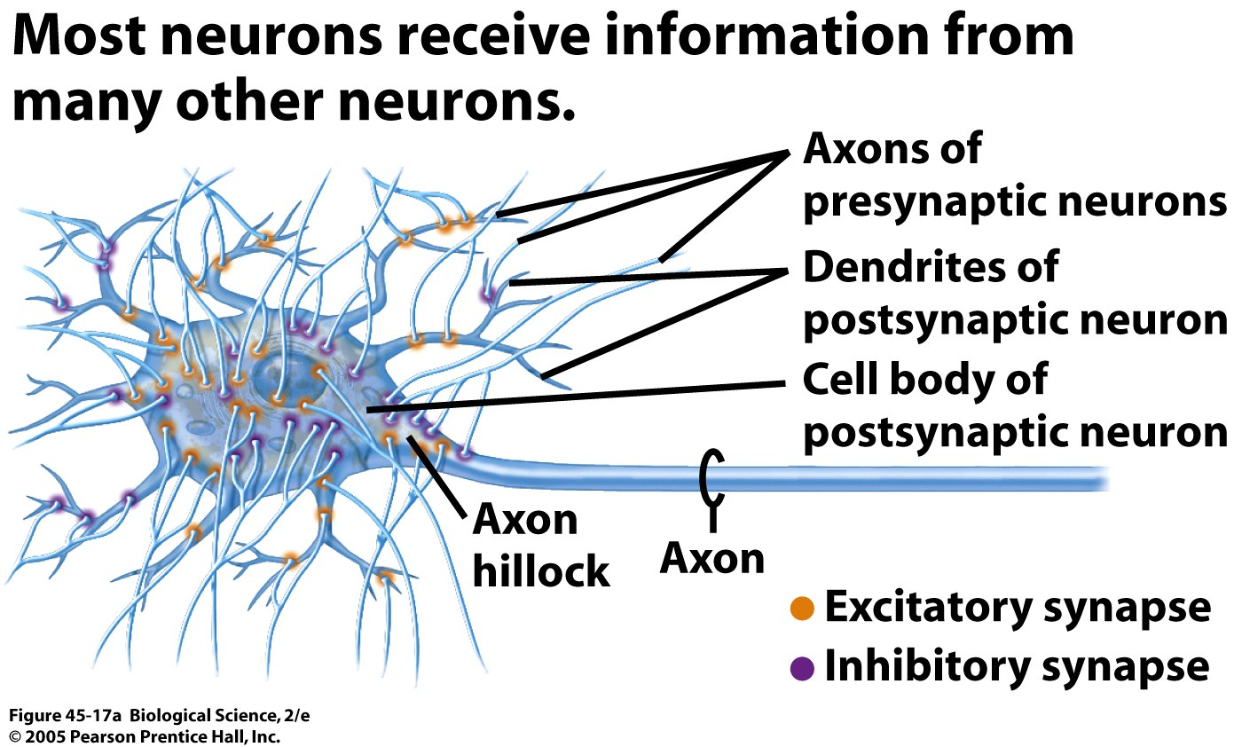
Information is integrated from many neurons
Notes:
If the membrane at the axon hillock depolarizes past a point termed the threshold, enough sodium channels open to trigger positive feedback and an action potential. Once an action potential starts at the axon hillock, it propagates down the axon to the next synapse .
After its release, the neurotransmitter Diffuses out of the synaptic cleft; May be taken up by surrounding cells and degraded by enzymes
Since most neurons have many synapses on their dendrites and cell body A single EPSP is usually too small to trigger an action potential in a postsynaptic neuron

Slide 18
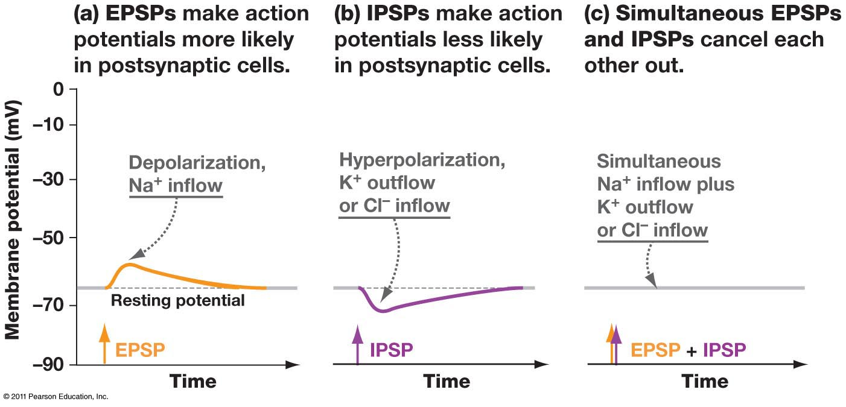
Postsynaptic potentials
Postsynaptic potentials (the effect on the membrane of the next neuron) can either promote or inhibit an action potential in the next neuron
Excitatory postsynaptic potentials (EPSPs)
Inhibitory postsynaptic potentials (IPSPs)
Notes:
If two EPSPs are produced in rapid succession An effect called temporal summation occurs
In spatial summation EPSPs produced nearly simultaneously by different synapses on the same postsynaptic neuron add together
Through summation An IPSP can counter the effect of an EPSP
EPSPs and IPSPs are not all-or-none events but are graded in size and short-lived. The size of an EPSP or IPSP depends on the amount of neurotransmitter that is released at the synapse.

Slide 19
In terms of signal integration, EPSPs and IPSPs have three important properties:
They’re graded: magnitude of EPSP or IPSP depends on amount of neurotransmitter
They’re extremely short-lived: neurotransmitters are quickly inactivated or recycled
They’re additive: The effect of EPSP’S and IPSP’S on postsynaptic cell; if post-synaptic potentials occur close together in space or time, their effects “sum”

Slide 20
Major neurotransmitters in animals
Acetylcholine
Is one of the most common neurotransmitters in both vertebrates and invertebrates
Enzyme in synaptic cleft hydrolyzes molecule
Can be excitatory or inhibitory
Monoamines
Include epinephrine, norepinephrine, dopamine, and serotonin
In the central nervous system, affect sleep, mood, attention
In the peripheral nervous system, typically excitatory
Amino acids
GABA is inhibitory by increasing membrane permeability of Cl⁻
Neuropeptides
Endorphins decrease pain perception
Gases
NO (nitric oxide) stimulates intra-cellular cascade to affect cell membrane
Notes:
Nicotine interferes with function by binding the cell receptors.
Botox is a treatment that inhibits presynaptic release of acetylcholine to block wrinkles from facial muscles
LSD, mescaline & other psychoactive drugs produce hallucinations by binding to receptors of serotonin and dopamine
Parkinson’s disease is associated with low dopamine
To treat depression, meds increase the concentrations of biogenic amines (prozac inhibits uptake of serotonin to increase effect)

Slide 21
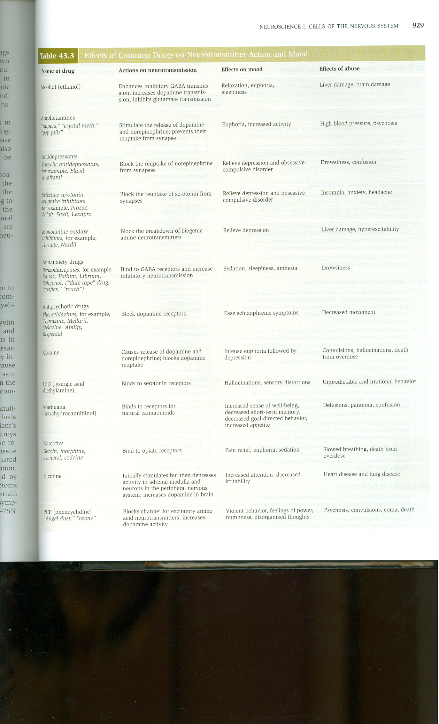
Table 43.3 Brooker et al. 2008. Biology.
Notes:
FYI only

Slide 22
Table 43.3 Brooker et al. 2008. Biology.
Notes:
FYI only

